Slide 1
IT2050 - COMPUTER NETWORKS
Lecture 2
IP Addressing
Ms.Hansika Mahaadikara

Slide 2
Addressing with TCP/IP
MAC Address
IP Address
Port Address
Identify a Computer
Identify a Process

Slide 3
Physical Address
Stored in the Network Interface Card (NIC)
A hardware setting set by the manufacturer of NIC .
Unchangeable
Ex :- MAC address
For Ethernet, the MAC address is a 48 bit or 12 Hex number
Ex : 5A:B3:87:F1:93:7C
5A-B3-87-F1-93-7C
MAC address operates in the Data Link Layer (Layer 2)
Ethernet Frame
CRC/FCS | DATA | DA | SA | SOF | Preamble

Slide 4
Logical Address
Address scheme depends on the used protocol
Widely used protocol is TCP/IP
Ex :- IP Address
192.168.16.53
10.39.40.3
Logical address operates at the Network Layer (Layer 3)

Slide 5
IP Address
Uniquely identifies devices
IP Addresses
IP Version 4 (IPV4)
32 bit scheme
IP Version 6 (IPV6) (IPng)
128 bit scheme

Slide 6
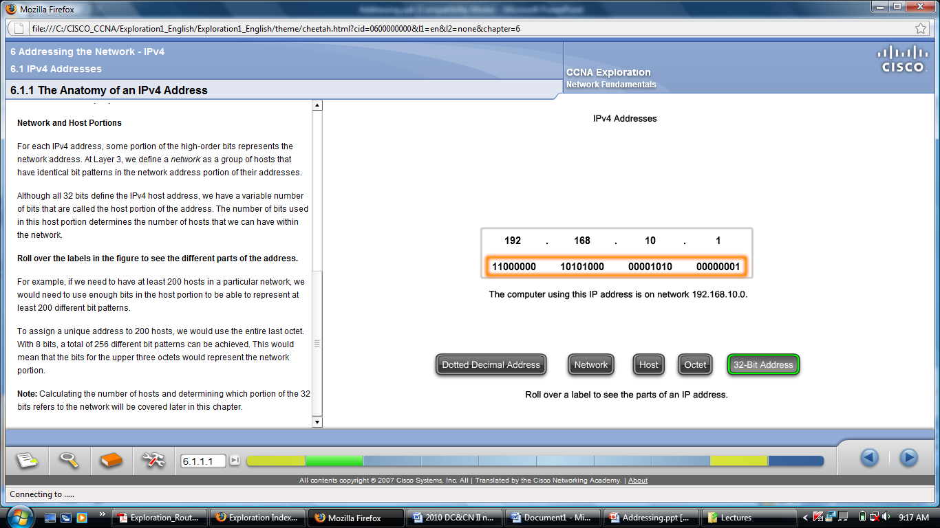
IP Version 4 (IPV4)
The 32 bits are represented in following manner.
Byte 1. Byte 2. Byte 3. Byte 4
( 1 byte = 8 bits)

Slide 7
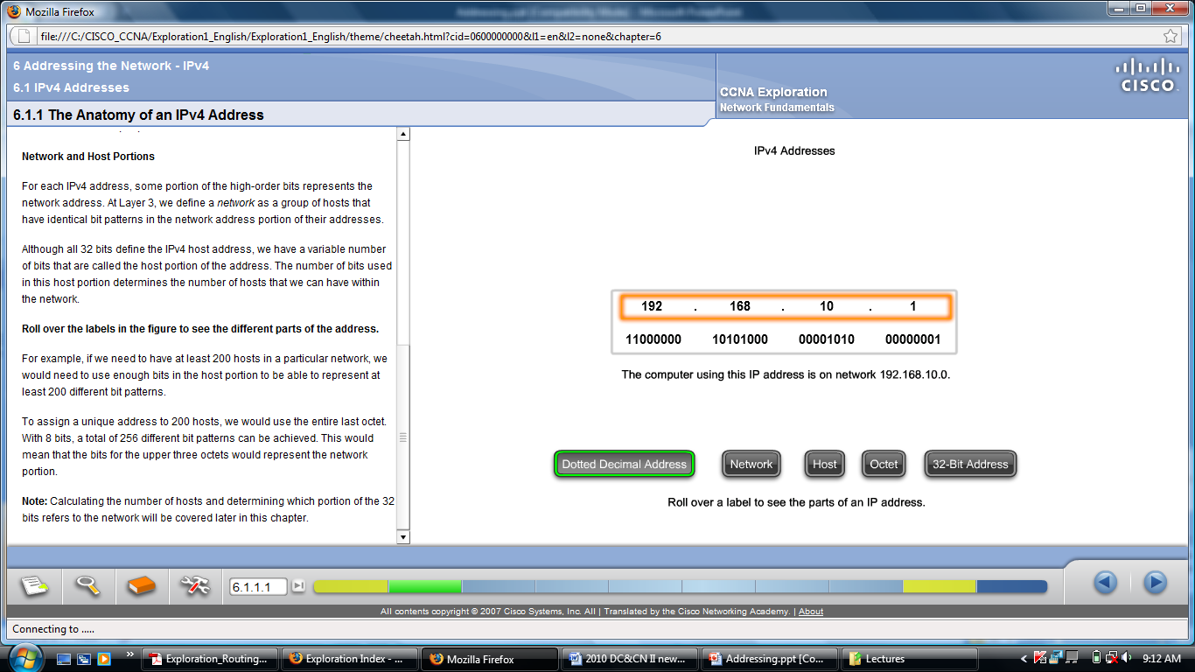
IP Version 4 (IPV4) cont.

Slide 8
IP Version 4 (IPV4) cont.
The minimum value of a byte
00000000 = 0
The maximum value of a byte
11111111 = 255
The minimum IP Address
0.0.0.0
The maximum IP Address
255.255.255.255

Slide 9
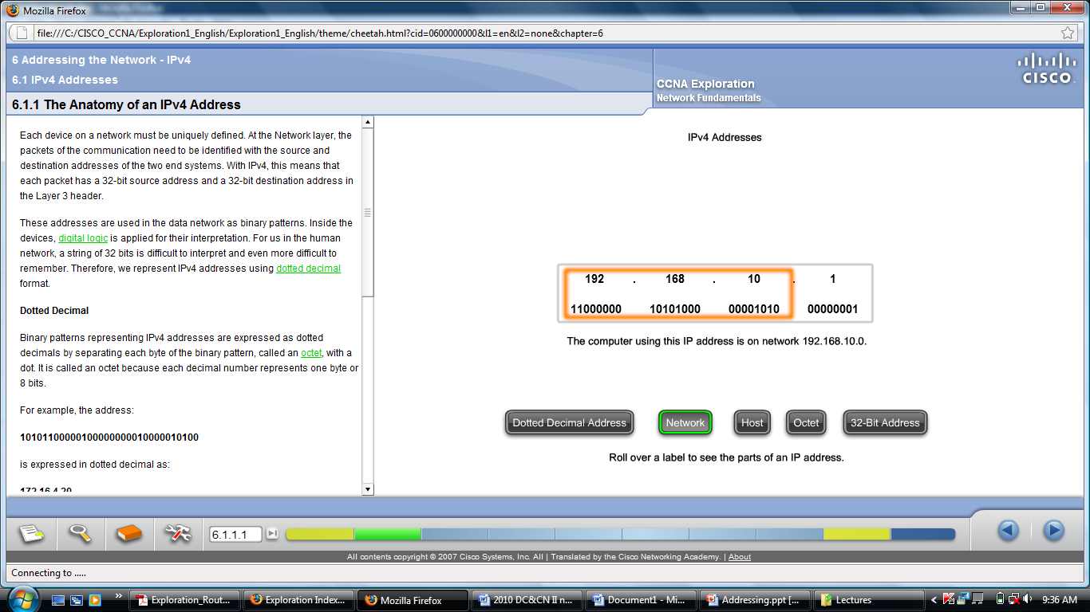
Network ID and Host ID
IP Addresses ➔ Network ID + Host ID
Classes of IP addresses
Class | Net ID | Host ID
A | 1 Byte | 3 Bytes
B | 2 Bytes | 2 Bytes
C | 3 Bytes | 1 Byte

Slide 10
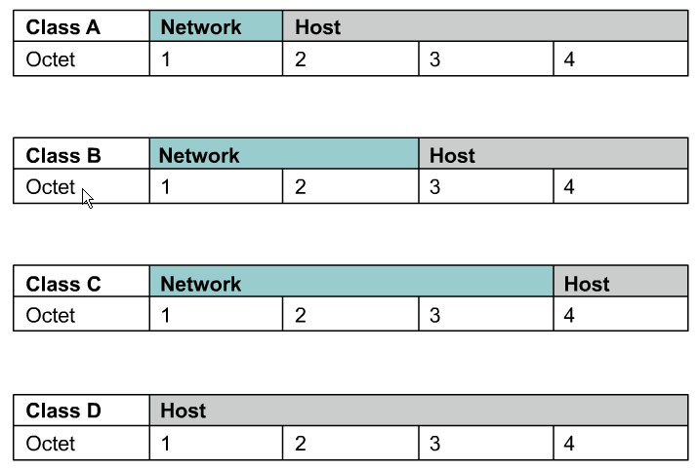
IPv4 Address Classes

Slide 11
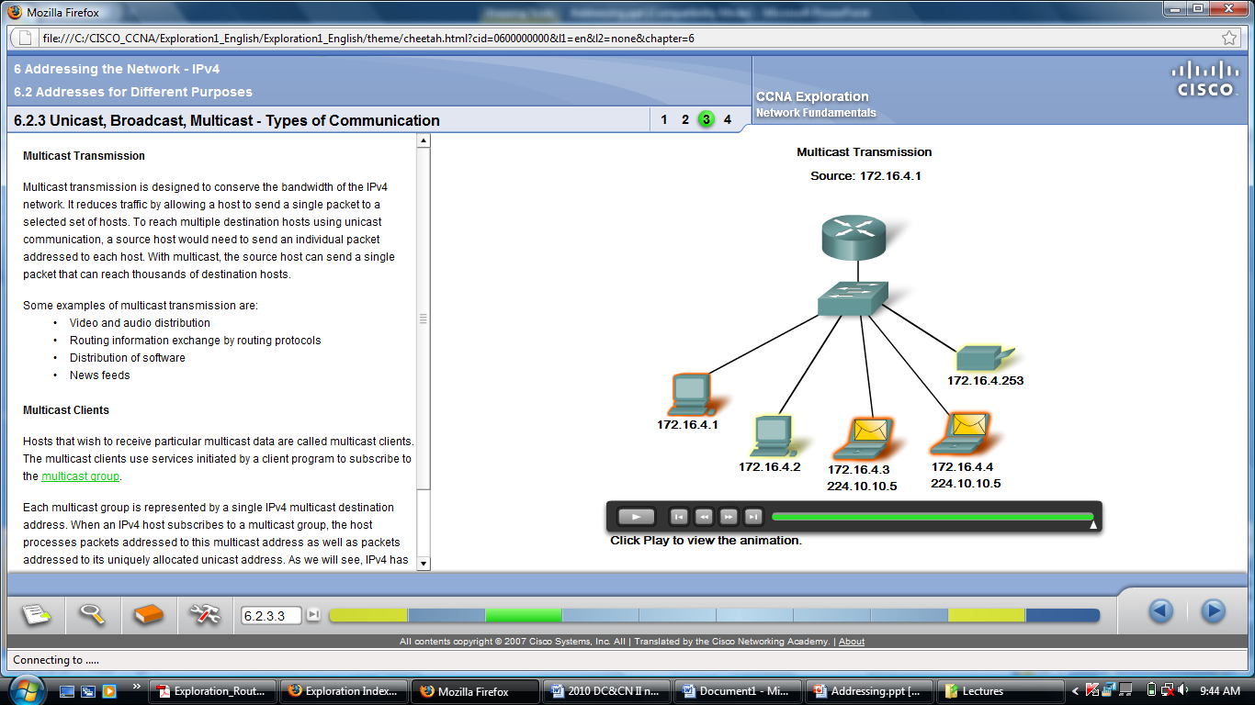
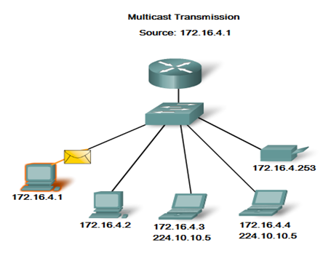
Classes of IP addresses cont.
Class D is introduced for Multicasting
Class E is reserved

Slide 12
Classes of IP addresses cont.
Class D Addresses
A Class D address begins with binary 1110 in the first octet.
First octet range 224 to 239.
Class D address can be used to represent a group of hosts called a host group, or multicast group.
Class E Addresses
First octet of an IP address begins with 1111
Class E addresses are reserved for experimental purposes and should not be used for addressing hosts or multicast groups.

Slide 13
Class | Minimum Network ID | Maximum Networks ID
A | 0 0000000 0 | 0 1111111 127
B | 10 000000.00000000 128.0 | 10 111111.11111111 191.255
C | 110 00000.00000000.00000000 192.0.0 | 110 11111.11111111.11111111 223.255.255

Slide 14
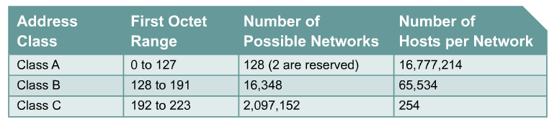
Class A – 2^7
Class B – 2^14
Class C – 2^21

Slide 15
Network Address and Broadcast Address
For the Network Address, the Host ID part of the IP Address will be considered as All 0s
For the Broadcast Address, the Host ID part of the IP Address will be considered as All 1
Ex : 103.58.35.1
This is a Class A address
Net ID is = 103
Host ID is = 58.35.1
Network Address ➔ 103.0.0.0
Broadcast Address ➔ 103.255.255.255

Slide 16
198 . 8 . 0 . 1
1100 0110 . 0000 1000 . 0000 0000 . 0000 0001
Both in Network ID and Host ID all 0s and all 1s are reserved for special purposes.
The actual maximum no. of Hosts per Network
=2⁸ - 2 = 254
Network Address :
1100 0110 . 0000 1000 . 0000 0000 . 0000 0000 (198.8.0.0)
Broadcast Address :
1100 0110 . 0000 1000 . 0000 0000 . 1111 1111 (198.8.0.255)
Class C
Network ID : 3 bytes (24 bits)
Host ID : 1 byte (8 bits)

Slide 17
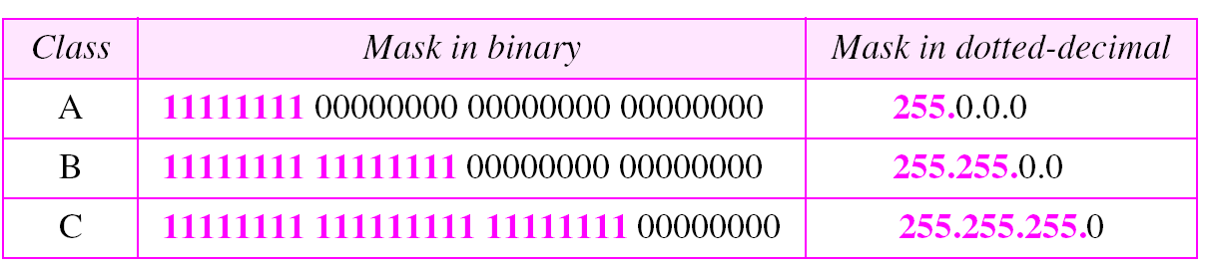
Classful Addressing - Subnet Mask
Net ID part : All 1’s
Host ID part : All 0’s

Slide 18
Exercise
IP Address | Class | Subnet Mask | Actual No.of hosts | Network Address | Broadcast Address
140.35.45.55
50.60.70.5
201.35.40.201
125.38.55.185
193.201.55.105
127.53.35.10

Slide 19
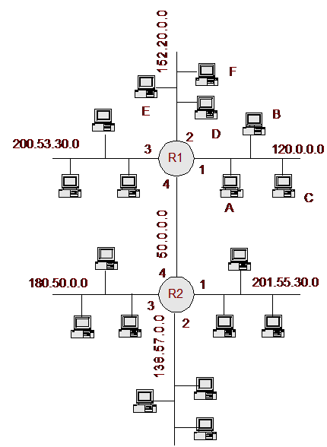
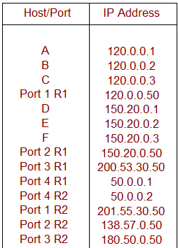
IP address of a Router
A router has many ports. (LAN and WAN Ports)
An IP address is assigned to each port.

Slide 20
Default Gateway IP Address
Network Address | Gateway IP Address
120.0.0.0 | 120.0.0.50
152.20.0.0 | 152.20.0.50
200.53.30.0 | 200.53.30.50
201.55.30.0 | 201.55.30.50
138.57.0.0 | 138.57.0.50
180.50.0.0 | 180.50.0.50
The IP address of router port which is connected to a particular LAN is called the “Gateway IP Address” of the LAN

Slide 21
Public IP Addresses
A public IP address is any valid address that can be accessed over the Internet
The Internet is a Public Computer Network which is spread all over the world.
Allocations of IP addresses are controlled by the Internet Assigned Number Authority (IANA) which responsible for the IP address ranges allocation to different countries.
CINTEC assigns different range of IP address to different Internet Service Providers (ISPs)
The ISPs allocate IP addresses to their customers
Sri Lanka Telecom(SLT) provides allocates 8 IP addresses for each 64 kb/s leased line.

Slide 22
Private IP Addresses
A private IP address is address assigned to a device on a private LAN that is accessible only within the LAN.
A network which is not connected to Internet can use any IP address range without obtaining any permission
It is not advisable to use any IP address since the network may connect to Internet in the future
To avoid such problems, IANA has reserved some IP address ranges for private use
Class | Private Network Address | No.of Networks
A | 10.0.0.0 | 1
B | 172.16.0.0 to 172.31.0.0 | 16
C | 192.168.0.0 to 192.168.255.0 | 256

Slide 23
IP special addresses
 | Net ID | Host ID | Remarks
Network Address | Specific | All 0’s | None
Direct Broadcast Address | Specific | All 1’s | Destination Address
Limited Broadcast Address | All 1’s | All 1’s | Destination Address
This Host on this Network | All 0’s | All 0’s | Source Address
Specific host on this network | All 0’s | Specific | Destination Address
Loopback Address | 127 | Any | Destination Address

Slide 24
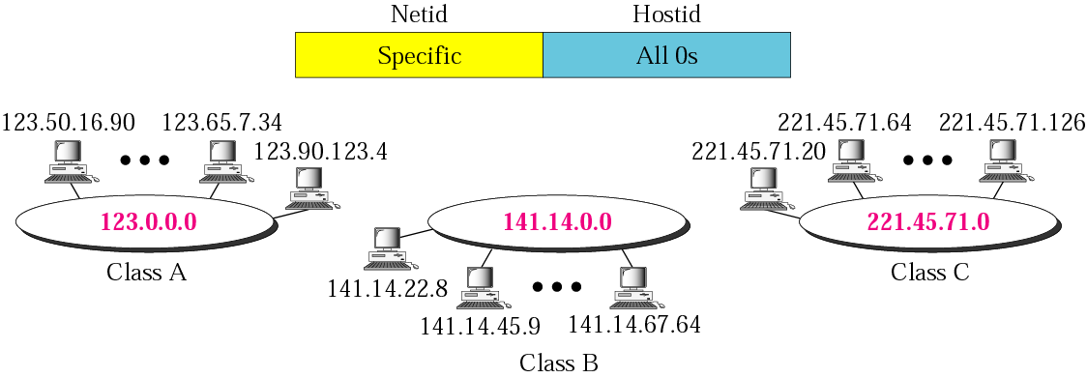
Network Address

Slide 25
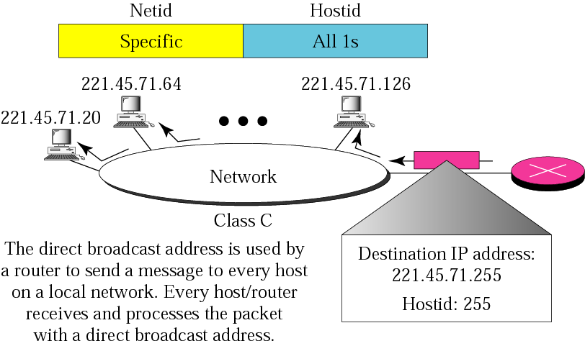
Direct Broadcast Address

Slide 26
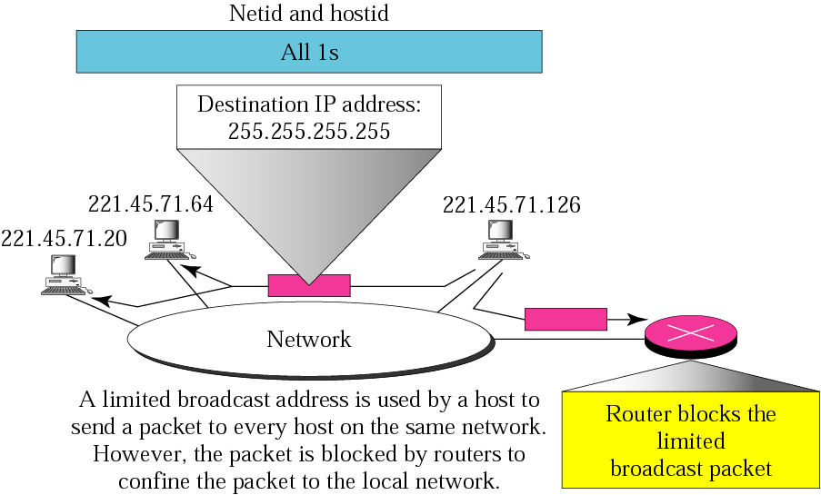
Limited Broadcast Address

Slide 27
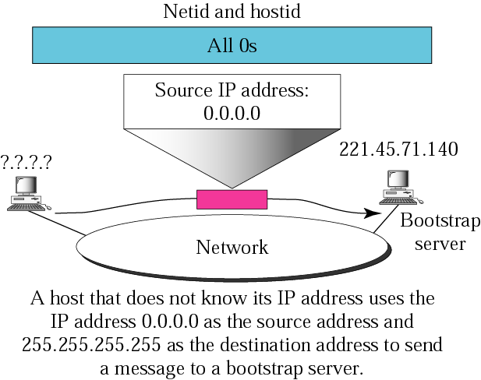
This host on this network

Slide 28
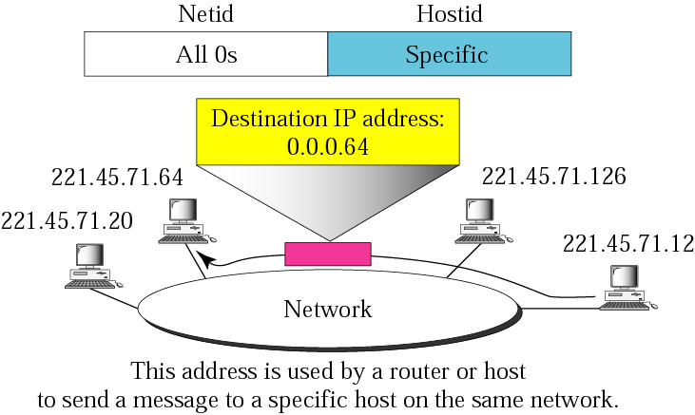
Specific host on this network

Slide 29
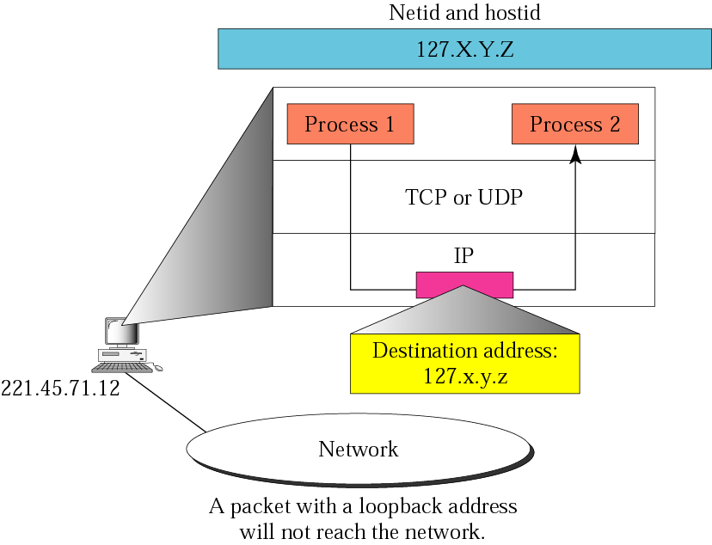
Loopback address

Slide 30
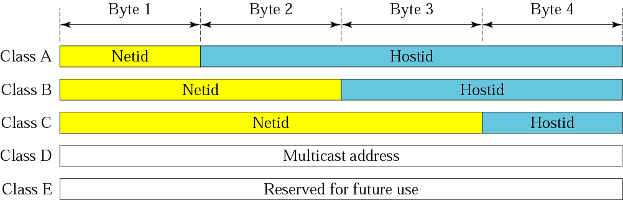
Classful Addressing

Slide 31
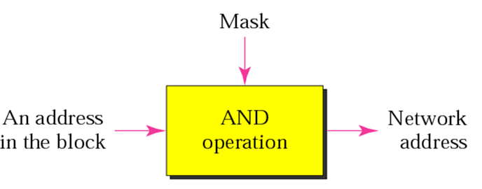
Masking Concept

Slide 32
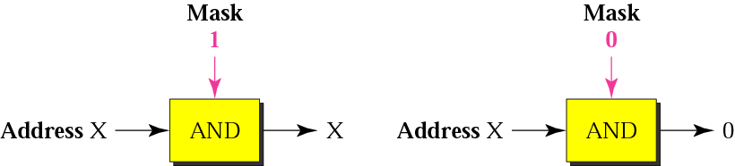
AND Operation

Slide 33
Subnetting – Classless Addressing
Suppose you are given a network address 150.100.0.0 /16 for your network.
10010110.01100100.00000000.00000000
You have the computers of Finance, Production and Administration Sections. In order to enhance the efficiency of network you want divide this into three networks. But you cannot get another two network addresses. This requirement can be satisfied from the same network address by using the subnet concept.
Now the IP address is divided into three parts.
Net ID Subnet ID Host ID

Slide 34
Classless Addressing cont.
The original Net ID bits not changed.
Part of Host ID is allocated for “Subnet ID”.
Most significant bits allocated as Subnet ID.
XXXX XXXX. XXXX XXXX.. XXXX XXXX. XXXX XXXX
Net ID Subnet ID Host ID

Slide 35
Classless Addressing cont.
subnets can be written as
Subnet 0 10010110.01100100.00000000.00000000
Subnet 1 10010110.01100100.01000000.00000000
Subnet 2 10010110.01100100.10000000.00000000
Subnet 3 10010110.01100100.11000000.00000000
In dotted decimal, it can be written as,
Subnet 0 address 150.100.0.0 /18
Subnet 1 address 150.100.64.0 /18
Subnet 2 address 150.100.128.0 /18
Subnet 3 address 150.100.192.0 /18

Slide 36
Classless Addressing cont.
For the above example the Finance, Production and Administration Sections can be put to three subnets as follows.
Consider the hosts in subnet 150.100.64.0
The IP addresses can be given as
150.100.64.1
150.100.64.2
150.100.64.3
150.100.64.4 etc.

Slide 37
Classless Addressing cont.
In classless addressing the number of bits for network address cannot be decided.
Indicated with a “/” symbol.
The IP address is written as,
150.100.64.1 /18
150.100.64.2 /18
150.100.64.3 /18
the subnet mask will be,
11111111.11111111.11000000.00000000
255.255.192.0

Slide 38
Write the possible 12 subnet addresses of 150.72.0.0 / 16 network.
150.72.0.0 / 20
150.72.16.0 / 20
150.72.32.0 / 20
150.72.48.0 / 20
150.72.64.0 / 20
150.72.80.0 / 20
<>
150.72.96.0 / 20
150.72.112.0 / 20
150.72.128.0 / 20
150.72.144.0 / 20
150.72.160.0 / 20
150.72.176.0 / 20

Slide 39
VLSM
Variable Length Sub-netting

Slide 40
An organization is granted the block 130.34.12.64/26. The organization needs 4 subnets. What is the subnet prefix length?
Solution We need 4 subnets, which means we need to add two more bits (log₂ 4 = 2) to the site prefix. The subnet prefix is then /28.

Slide 41
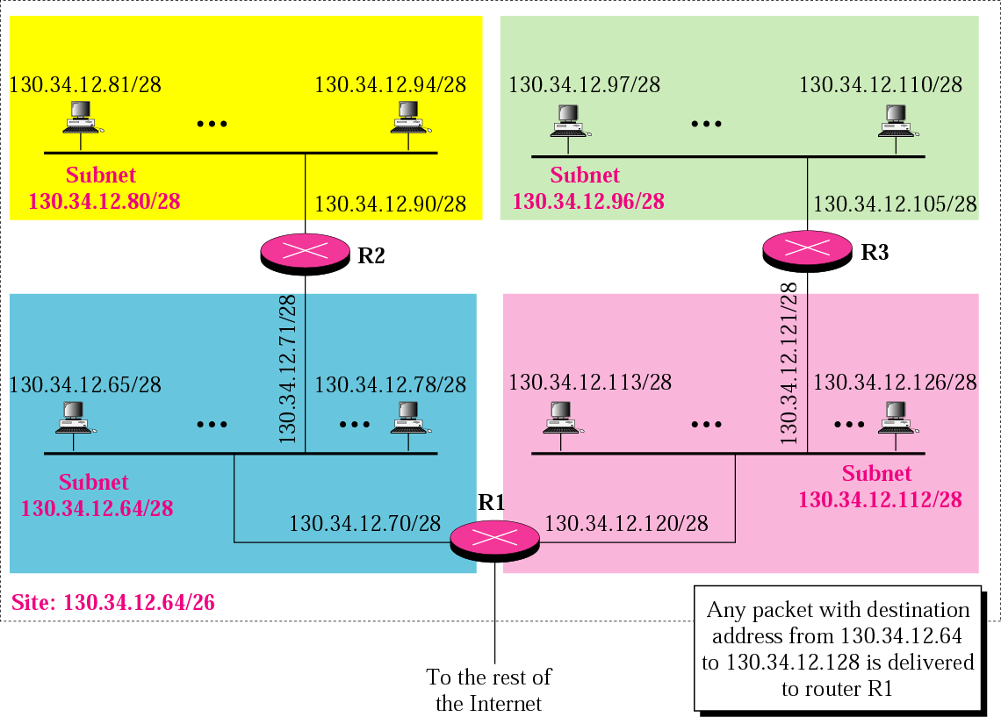

Slide 42
VLSM
Variable Length subnet Masking
The number of devices are not equal in all the subnets
Prefixes vary for separate subnets

Slide 43
Class-full routing
Only allows for one subnet mask for all networks
VLSM & Classless routing
The process of subnetting a subnet
More than one subnet mask can be used
More efficient use of IP addresses as compared to classfull IP addressing

Slide 44
An organization is granted a block of addresses with the beginning address 14.24.74.0/24. There are 2³²⁻²⁴= 256 addresses in this block. The organization needs to have 11 subnets as shown below:
a. 2 subnets, each with 64 addresses.
b. 2 subnets, each with 32 addresses.
c. 3 subnets, each with 16 addresses.
d. 4 subnets, each with 4 addresses.
Design the subnets.

Slide 45
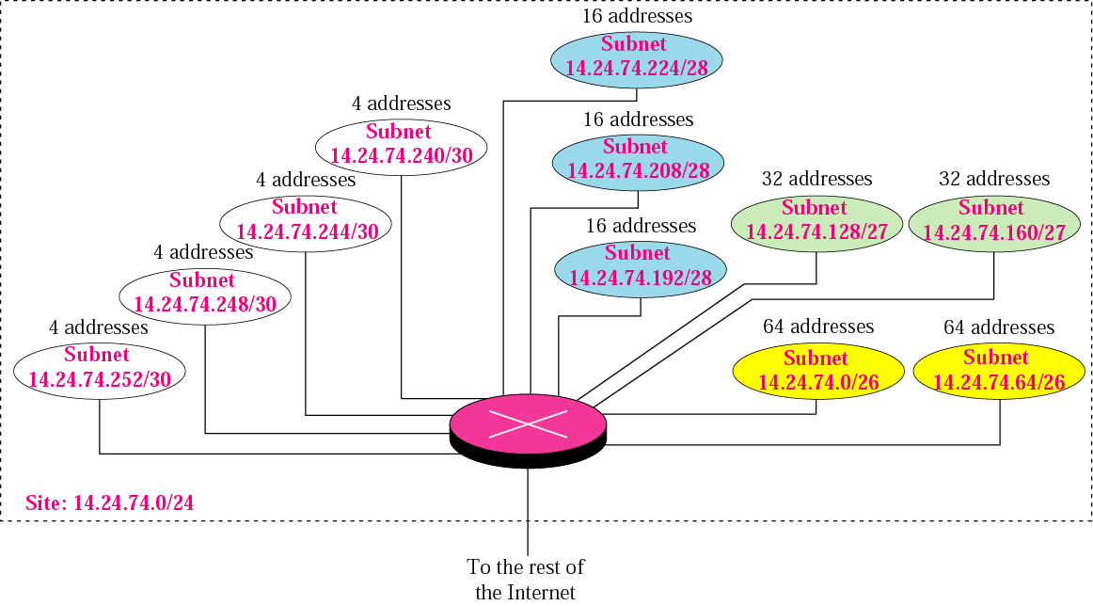

Slide 46
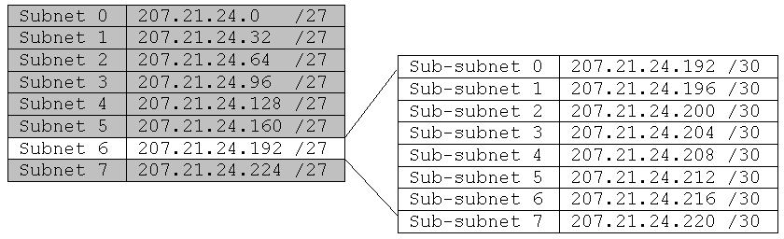
VLSM Example using /30 subnets
207.21.24.0/24 network subnetted into eight /27 (255.255.255.224) subnets
This network has seven /27 subnets with 30 hosts each AND eight /30 subnets with 2 hosts each.
/30 subnets are very useful for serial networks.
207.21.24.192/27 subnet, subnetted into eight /30 (255.255.255.252) subnets

Slide 47
207.21.24.192/27 207.21.24. 11000000
/30 Hosts Bcast 2 Hosts
0 207.21.24.192/30 207.21.24. 110 00000 01 10 11 .193 & .194
1 207.21.24.196/30 207.21.24. 110 00100 01 10 11 .197 & .198
2 207.21.24.200/30 207.21.24. 110 01000 01 10 11 .201 & .202
3 207.21.24.204/30 207.21.24. 110 01100 01 10 11 .205 & .206
4 207.21.24.208/30 207.21.24. 110 10000 01 10 11 .209 & .210
5 207.21.24.212/30 207.21.24. 110 10100 01 10 11 .213 & .214
6 207.21.24.216/30 207.21.24. 110 11000 01 10 11 .217 & .218
7 207.21.24.220/30 207.21.24. 110 11100 01 10 11 .221 & .222

Slide 48
207.21.24.192/30
207.21.24.204/30
207.21.24.192/30
207.21.24.204/30
207.21.24.216/30
207.21.24.216/30
207.21.24.96/27
207.21.24.128/27
207.21.24.64/27
207.21.24.64/27
207.21.24.208/30
207.21.24.196/30
207.21.24.196/30
207.21.24.200/30
207.21.24.212/30
207.21.24.160/27
207.21.24.224/27
207.21.24.32/27
207.21.24.0/27
207.21.24.160/27
207.21.24.224/27
This network has seven /27 subnets with 30 hosts each AND seven /30 subnets with 2 hosts each (one left over).
/30 subnets with 2 hosts per subnet do not waste host addresses on serial networks .

Slide 49
VLSM and the Routing Table
Displays one subnet mask for all child routes. Classful mask is assumed for the parent route.
Routing Table without VLSM
RouterX#show ip route
207.21.24.0/27 is subnetted, 4 subnets
C 207.21.24.192 is directly connected, Serial0
C 207.21.24.196 is directly connected, Serial1
C 207.21.24.200 is directly connected, Serial2
C 207.21.24.204 is directly connected, FastEthernet0
Routing Table with VLSM
RouterX#show ip route
207.21.24.0/24 is variably subnetted, 4 subnets, 2 masks
C 207.21.24.192 /30 is directly connected, Serial0
C 207.21.24.196 /30 is directly connected, Serial1
C 207.21.24.200 /30 is directly connected, Serial2
C 207.21.24.96 /27 is directly connected, FastEthernet0
Each child routes displays its own subnet mask. Classful mask is included for the parent route.
Parent Route shows classful mask instead of subnet mask of the child routes.
Each Child Routes includes its subnet mask.

